Slide 1
Web-scraping the Wild West:
How to capture web corpora with nothing but a lasso
Flash talk for SICSS 2019
By Jaren Haber, PhD Candidate, Sociology,
UC Berkeley
View & comment on these slides:
http://tinyurl.com/webscraping-sicss
Notes:
https://docs.google.com/presentation/d/1zoCpTk7EEVT8YjA8WNRaX-jGp0jHLidLldeYGHB2M9Q/edit?usp=sharing

Slide 2
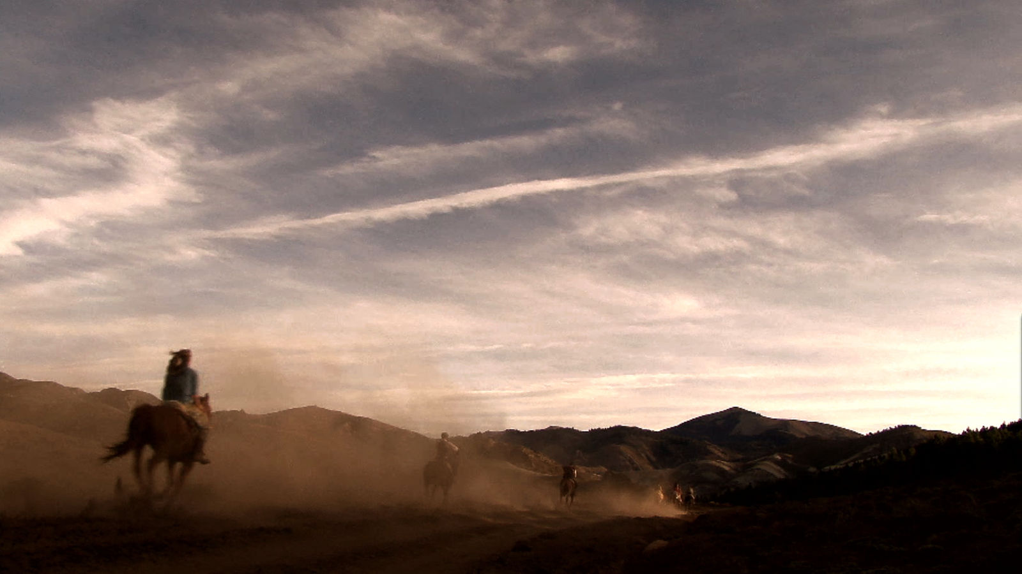
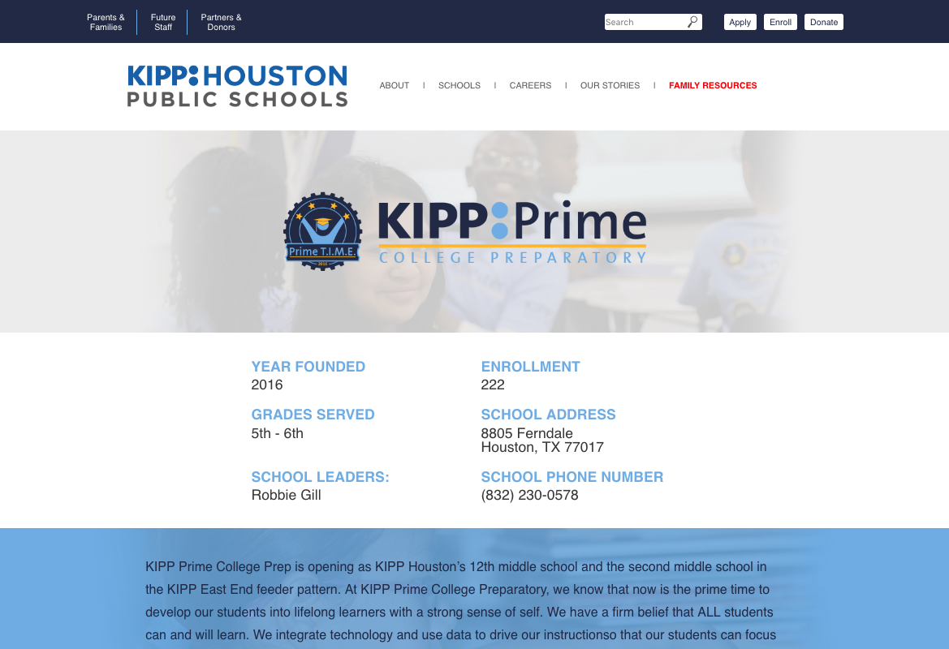
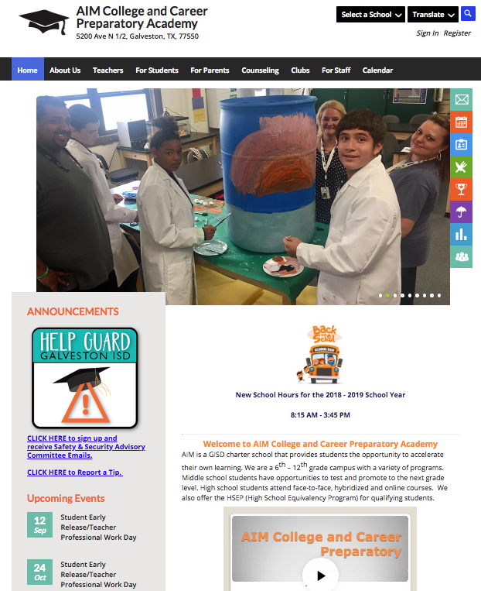
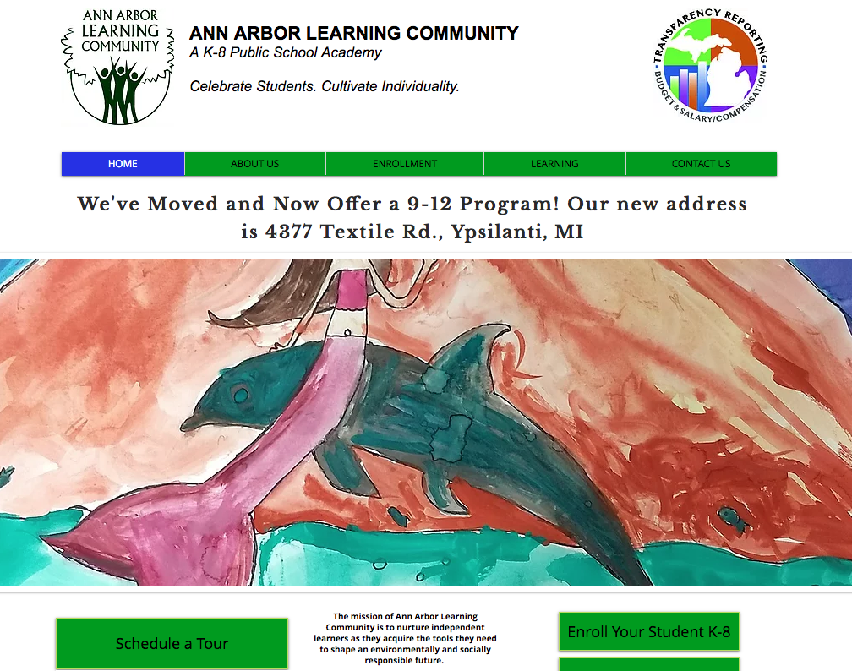
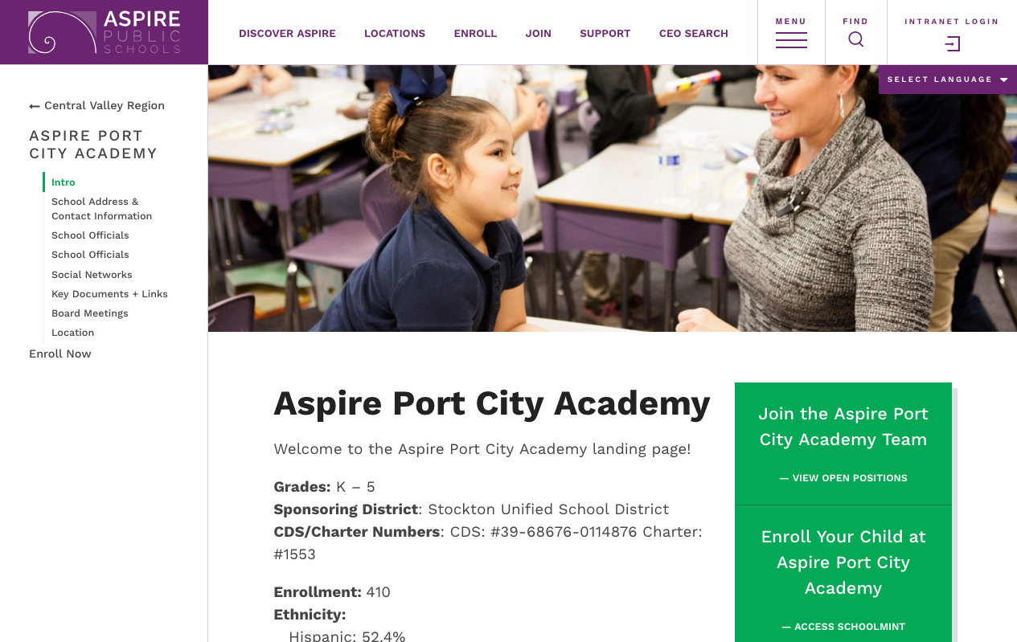

Slide 3
Web-scraping decision hierarchy
Existing data
Web API
Structured
HTML
Wild West
List of entities
Scrape URLs
Scrape HTML
Parse HTML
Store output
Filter content
No scraping
Easy scraping
Structured
scraping
Notes:
Target: Website self-descriptions for all charter schools operating in the 2015-16 school year
Shortcuts:
Existing database?
API?
Web-crawling! Which typically means:
Consistent website structure to guide format of queries?
Established best practices for reliably grabbing diverse web content?

Slide 4
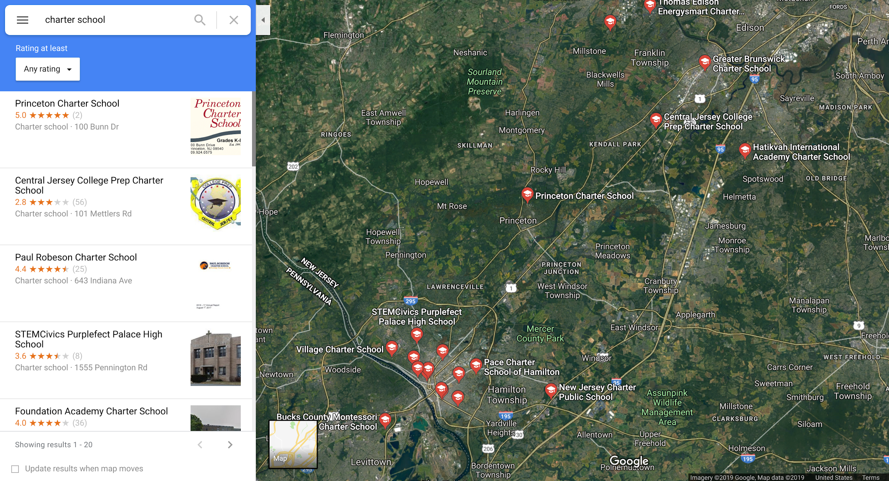
Scraping URLs

Slide 5
Scraping HTML

Slide 6
Parsing HTML
def parsefile_by_tags(HTML_file):
"""Cleans HTML by removing inline tags, ripping out non-visible tags, replacing paragraph tags
with a random string, and finally using this to separate HTML into chunks."""
random_string = "".join(map(chr, os.urandom(75))) # Create random string for tag delimiter
soup = BeautifulSoup(open(HTML_file), "lxml")
inline_tags = ["b", "big", "i", "small", "tt", "abbr", "acronym", "cite", "dfn", "em", "kbd", "strong", "samp", "var", "bdo", "map", "object", "q", "span", "sub", "sup"] # junk tags to eliminate
[s.extract() for s in soup(['style', 'script', 'head', 'title', 'meta', '[document]'])] # Remove non-visible tags
for it in inline_tags:
[s.extract() for s in soup("</" + it + ">")] # Remove inline tags
visible_text = soup.getText(random_string).replace("\n", "") # Replace "p" tags with random string, eliminate ‘\n’
# Split text into list using random string, eliminate tabs, convert unicode to readable text:
visible_text = list(normalize("NFKC",elem.replace("\t","")) for elem in visible_text.split(random_string))
visible_text = list(filter(lambda vt: vt.split() != [], visible_text)) # Eliminate empty elements
return(visible_text)
Notes:
https://github.com/jhaber-zz/Charter-school-identities/blob/master/scripts/parsefile_by_tags.py

Slide 7
f =0 crawl approach: wget
wget https://www.kippbayarea.org/schools/bridge/
{https://www.kippbayarea.org/schools/sfbay/
https://www.kippbayarea.org/kipp-bayview-elementary/}
wget --no-parent --level 0 --no-check-certificate --recursive --adjust-extension --convert-links --page-requisites --wait=10 --random-wait --execute robots=off --follow-ftp --secure-protocol=auto --retry-connrefused --tries=12 --no-remove-listing --local-encoding=UTF-8 --no-cookies --default-page=default --server-response --trust-server-names --header="Accept:text/html" --user-agent=Mozilla --warc-file=bridge_warc --warc-cdx --warc-max-size=0.5G {URL}
--recursive Recursively download files and follow links
--no-parent Follow links, but not beyond the last parent directory
--page-requisites Grab all of the linked resources necessary to render the page (images, CSS, JS, etc.)
--adjust-extension Append .html to the files when appropriate
--convert-links Turn links into local links as appropriate
--execute robots=off Turn off wget's automatic robots.txt checking
--user-agent Mask the user agent and show wget like a browser
Notes:
For examples of wget usage, see https://gist.github.com/bueckl/bd0a1e7a30bc8e2eeefd
More wget options:
--exclude-directories Exclude CSV of directories from download
--random-wait Randomize wait to between 5 and 15 seconds
-O Download and store with a different file name
--background For a huge download, put the download in background
--tries Increase retry attempts
-i Download multiple files / URLs
--mirror Download a full website and make available for local viewing
-r -A Download only certain file types
--spider Determine whether the remote file exist at the destination (mimics web spiders)
--domains Download only only PDF files from specific domains
--user --password Download files from password protected sites
--http-user --http-password Download from password protected http sites

Slide 8
wget output
… xp=s\x92éëÊ00ÿ\r[ÖMission and VisionÈèüû]Dg̈\x98\x95\xad-\x01ê\x1bÿìö?YüoeF2æAv\x150TS \x8bS\x82 ÄÝ¤\x98rY-#cÌ\x16μäâ\x8d8@̄L\x01û\x80sÍ\x89xp=s\x92éëÊ00ÿ\r[ÖÈèüû]Dg ̈\x98\x95\xad-\x01ê\x1bÿìö?Yüo … x80sÍ\x89xp=s\x92éëÊ00ÿ\r[ÖBell ScheduleÈèüû]Dg ̈\x98\x95\xad-\x01ê\x1bÿìö?YüoeF2æAv\x150TS\x8bS\ x82Ä Ý¤\x98rY-#cÌ\x16μäâ\x8d8@ ̄L\x01û\x80sÍ\x89xp=s\x92éëÊ00ÿ\r[ÖÈèüû]Dg̈\x98\x95\xad-\x01ê\x1bÿìö … â\x8d8@ ̄L\x01û\x80sÍ\x89xp=s\x92éëÊ00ÿ\r[ÖCollege & Career ReadinessÈèüû]Dg̈\x98\x95\xad-\x01ê\x1 … x16μäâ\x8d8@̄L\x01û\x80sÍ\x89xp=s\x92éëÊ00ÿ\r[ÖStony Point Academy is committed to provide a rigorous preparatory program that ensures all students are ready for successful post-secondary pathway. This includes an academically rich curriculum with rigorous content. It includes an expectation that students will apply their knowledge through higher-order skills, and will develop the habits of mind and character traits known to support personal standards within a student-centered environment that emphasizes the Common Core Anchor Standards for College and Career Readiness (CCR) across all content areas at every grade level. It is with this preparation that students will become contributing members of the local and global communities.Èèüû]Dg̈\x98\x95\xad-\x01ê\x1bÿìö?YüoeF2æAv\x150TS\x8bS\x82ÄÝ¤\ x98rY-#cÌ\x16μäâ\x8d8 @ ̄L\x01û\x80sÍ\x89xp=s\x9 2éëÊ00ÿ\r[ÖÈèüû]Dg ̈\x98\x95\xad-\x01ê\x1bÿìö?YüoeF2æAv\x150TS\x8bS\x82
Notes:
http://www.spacharter.org/mission-and-vision.html

Slide 9
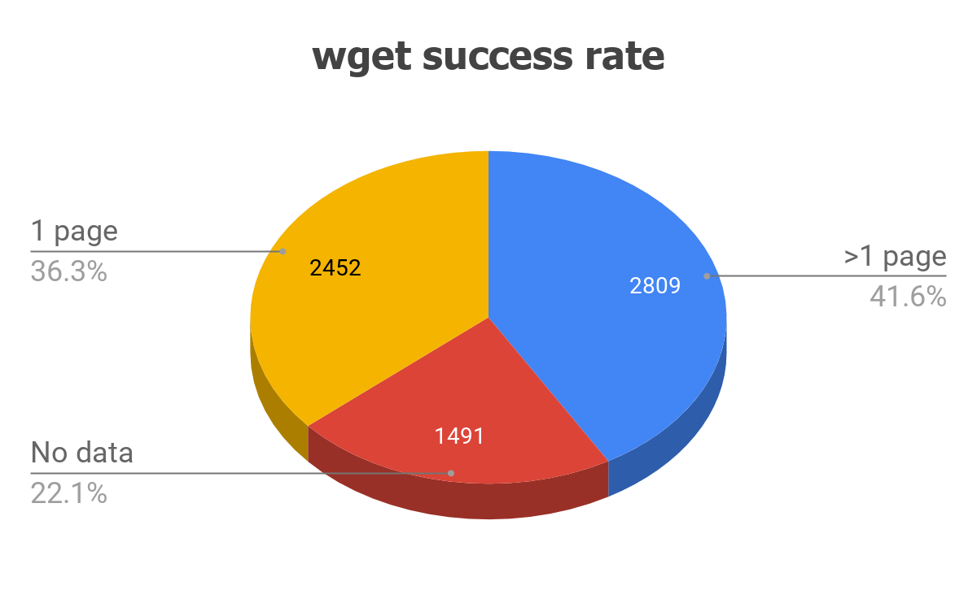
WGET RESULTS OF 300 SCHOOLS
162 … full data
17 … no data
Notes:
https://docs.google.com/spreadsheets/d/11ADOeZ_Vtp7RFWgMDcmVjH-y6k1H4JwfxAUdyjdH_g0/edit?usp=sharing
Compare schools that DIDN’T get downloaded with those that DID: in different areas? More poor or ethnic minority? Larger? Older?

Slide 10
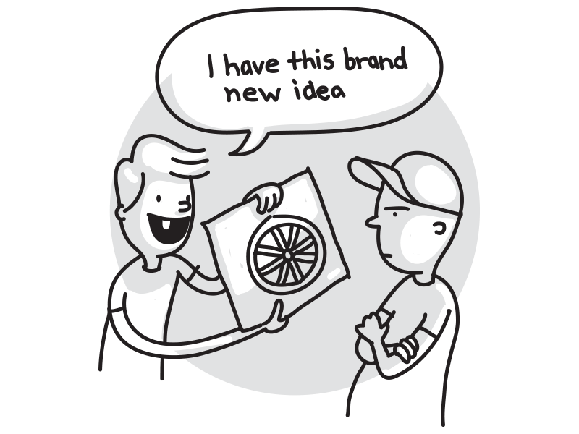
f +1 crawl approach: requests

Slide 11
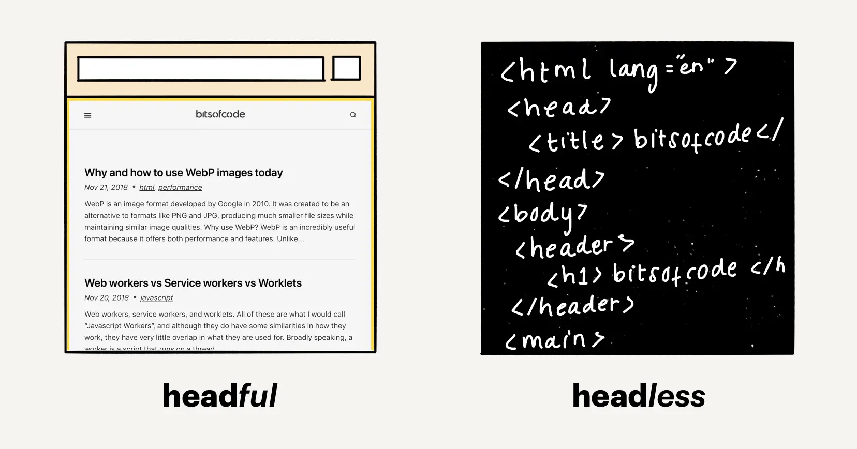
f +2 crawl approach: Selenium
Notes:
https://code.tutsplus.com/tutorials/modern-web-scraping-with-beautifulsoup-and-selenium--cms-30486

Slide 13
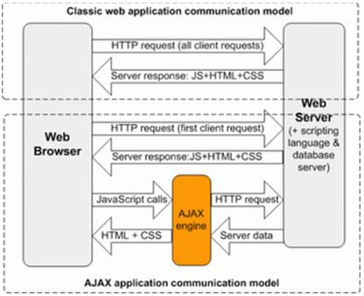

Slide 14
Selenium output
Home Our School
...
Mission and Vision
﻿
Stony Point Academy is committed to provide a rigorous preparatory program that ensures all students are ready for successful post-secondary pathway. This includes an academically rich curriculum with rigorous content. It includes an expectation that students will apply their knowledge through higher-order skills, and will develop the habits of mind and character traits known to support personal standards within a student-centered environment that emphasizes the Common Core Anchor Standards for College and Career Readiness (CCR) across all content areas at every grade level. It is with this preparation that students will become contributing members of the local and global communities.
Stony Point Academy
Building Future Leaders
Select Language
​
Job Opportunities
Contact us
Website Issues
Home
Our School
Mission and Vision
Bell Schedule
Meet our Staff
SARC
Food Services
Instructional Programs
Emergency Information
WASC
Admissions
Counseling
College & Career Readiness
Parents
Community Service
Student Handbook
Newsletter
>
Past Newsletters
Home Study
Contact Us
Map
Middle School & High School
<div style="display:none;"><img src="//pixel.quantserve.com/pixel/p-0dYLvhSGGqUWo.gif?labels=l10,u19285727.u19285727s888345291258728173" border="0" height="1" width="1" alt="Quantcast"/></div>
Notes:
http://www.spacharter.org/mission-and-vision.html
Full output: https://raw.githubusercontent.com/URAP-charter/web_scraping/master/Final%20Scrape%20Results/BELLEVUE%20UNION%20ELEMENTARY/spacharter.org-mission-and-vision.html-.txt

Slide 15
Limits of Selenium
[31mcrawler_10 |[0m 2018-04-05 21:42:10 [selenium.webdriver.remote.remote_connection] DEBUG: GET http://172.18.0.2:4444/wd/hub/session/a9700948ceef7d04568452492f07e968/element/ 0.786584017266313-80/attribute/href {"sessionId": "a9700948ceef7d04568452492f07e968", "name": "href", "id": "0.786584017266313-80"}
[36;1mcrawler_2 |[0m TypeError: can't pickle thread.lock objects
[32mcrawler_5 |[0m 2018-04-05 21:41:37 [selenium.webdriver.remote.remote_connection] DEBUG: GET http://172.18.0.2:4444/wd/hub/session/dcc13b350db90f2c33fccf3a6a15f850/element/ 0.3070402879225935-111/attribute/href {"sessionId": "dcc13b350db90f2c33fccf3a6a15f850", "name": "href", "id": "0.3070402879225935-111"}
[32;1mcrawler_9 |[0m 2018-04-05 21:42:29 [selenium.webdriver.remote.remote_connection] DEBUG: Finished Request
[36mcrawler_6 |[0m {'appid': u'testapp',
[35;1mcrawler_1 |[0m 2018-04-05 21:42:44 [selenium.webdriver.remote.remote_connection] DEBUG: GET http://172.18.0.2:4444/wd/hub/session/a0eaf0be3a4c7e187452951948b8a333/element/ 0.1420010272851573-52/attribute/href {"sessionId": "a0eaf0be3a4c7e187452951948b8a333", "name": "href", "id": "0.1420010272851573-52"}

Slide 16
f +3 crawl approach: Scrapy Cluster

Slide 17
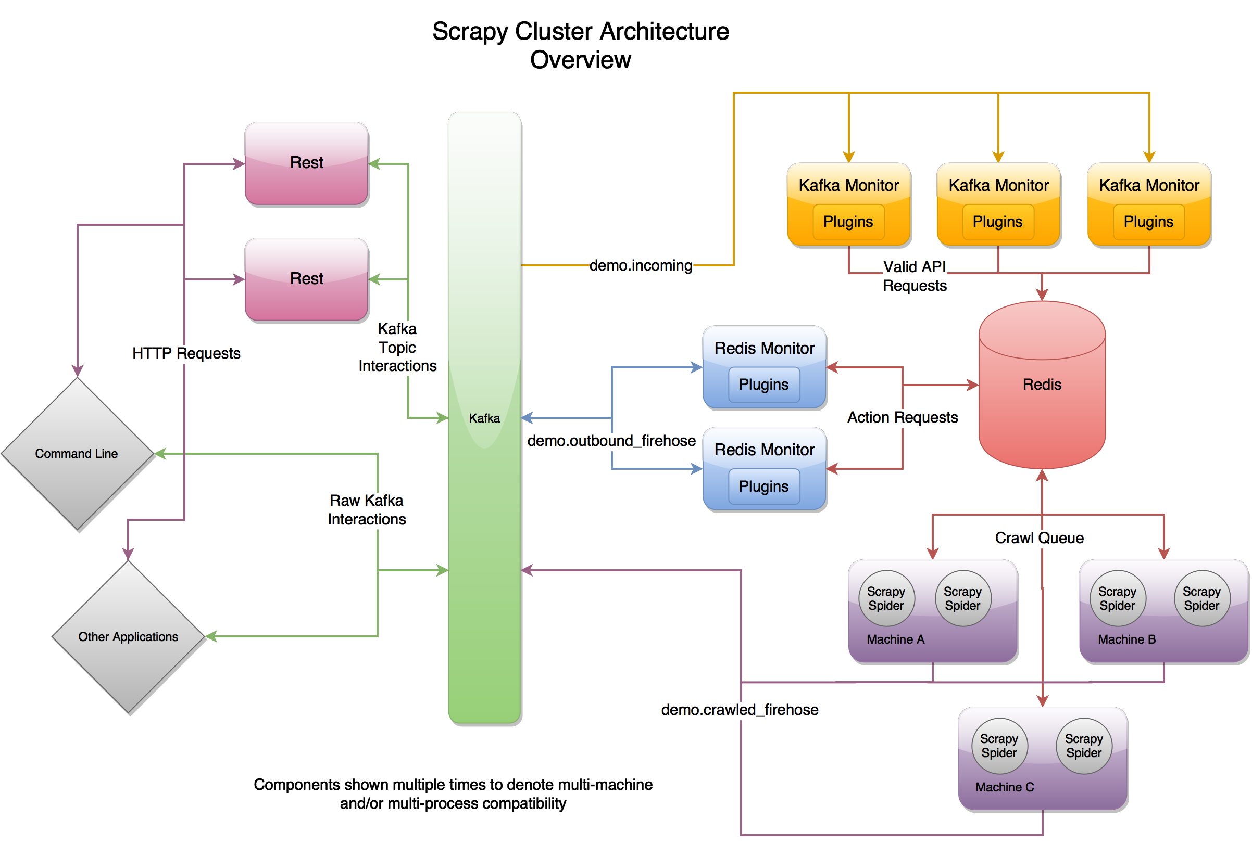
Notes:
http://scrapy-cluster.readthedocs.io/en/latest/topics/introduction/overview.html

Slide 18
Scrapy Cluster output
Home Our School ... Mission and Vision ﻿ Stony Point Academy is committed to provide a rigorous preparatory program that ensures all students are ready for successful post-secondary pathway. This includes an academically rich curriculum with rigorous content. It includes an expectation that students will apply their knowledge through higher-order skills, and will develop the habits of mind and character traits known to support personal standards within a student-centered environment that emphasizes the Common Core Anchor Standards for College and Career Readiness (CCR) across all content areas at every grade level. It is with this preparation that students will become contributing members of the local and global communities. Stony Point Academy Building Future Leaders Job Opportunities Contact us Website Issues Home Our School Mission and Vision Bell Schedule Meet our Staff SARC Food Services Instructional Programs Emergency Information WASC Counseling College & Career Readiness Parents Community Service Student Handbook Newsletter > Past Newsletters Home Study Contact Us Map Middle School & High School
Notes:
http://www.spacharter.org/mission-and-vision.html
Full output: https://raw.githubusercontent.com/URAP-charter/web_scraping/master/Final%20Scrape%20Results/BELLEVUE%20UNION%20ELEMENTARY/spacharter.org-mission-and-vision.html-.txt

Slide 19
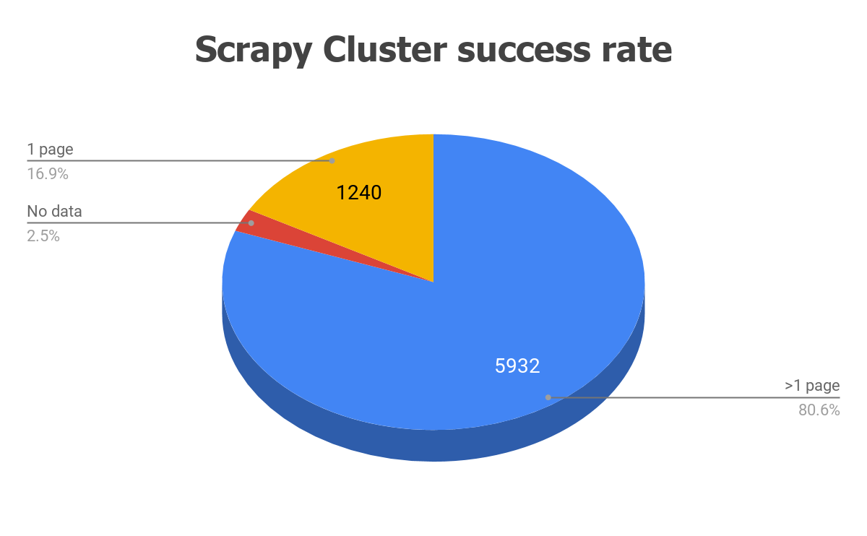
WGET RESULTS OF 300 SCHOOLS
162 … full data
17 … no data
Notes:
82 pages per crawlid on average, max 7371 pages
Compare schools that DIDN’T get downloaded with those that DID: in different areas? More poor or ethnic minority? Larger? Older?

Slide 20
Take-aways
Web-crawling new corpora (still) the Wild West
But don’t “reinvent the flat tire”
Cornerstone web-scraping tool (for Python): scrapy
Flexible, fast, strong community
Scrapy tutorial, URL scraper, etc.:
https://github.com/jhaber-zz/web_tools/

Slide 21
Thanks for your attention!
Jaren Haber
jhaber@berkeley.edu

